Slide 1
HTML AND JavaScript
Presented by:
Yogesh Chaudhary
Aman Mishra

Slide 2

HTML(Hyper Text Markup Language)
HTML was first developed by Tim Berners-Lee in 1990.
HTML tags are surrounded by angle brackets like<html>.
HTML tags normally comes in pair like <p> and</p>.

Slide 3
Getting Started
<p>Sometimes it’s better to bunk class and enjoy with friends , coz today when <strong>I look back marks</strong> never make me <em>laugh memories do</em>. </p>
RESULT : Sometimes it’s better to bunk class and enjoy with friends , coz today when I look back marks never make me laugh memories do.

Slide 4
Tags and Attributes
<p>….</p> Tags, opening and closing
<img/> Tags, self-closing
<img src=“gallery.jpg”/> Attributes in tags

Slide 5
The Heart Of The WEB
Hyperlinks:
<p>
<a href=“https://www.youtube.com”>Youtube</a>
</p>

Slide 6
IMAGES
<img src=“photogallery.jpg” alt=“Test picture” width=“400” height=“300” />

Slide 7
HTML STYLE ATTRIBUTES
Tags Description
<center> Defines centered content
<font> Defines html fonts
<u> Defines underlined text
Attributes: Description:
align Defines the alignment of text
bgcolor Defines the background color
Color Defines the text color

Slide 8
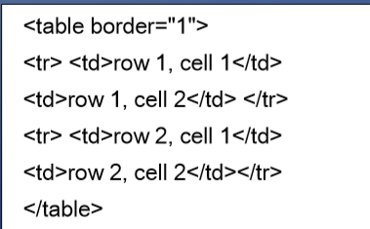
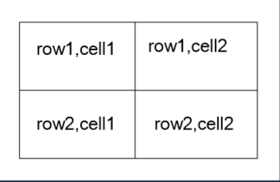
HTML TABLES
Defined with <table> tag.
A table is divided into rows(with the <tr> tag).
Each row is divided into data cells(with the <td> tag)

Slide 9
HTML FORMS
Form elements are elements that allow the user to enter information like,
Text fields,
Textarea fields,
Drop-down menus,
Radio buttons,
Checkbox,etc

Slide 10
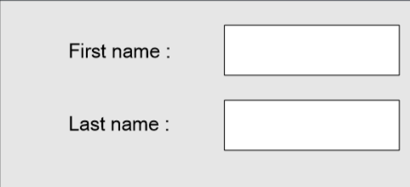
TEXT FIELDS
Text fields are used when you want the user to type letters, numbers, etc. in a form.
Example:
<form>
First name:<input type=“text” name=“firstname” /> </br>
Last name: <input type=“text” name=“lastname” />
</form>

Slide 11
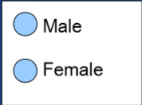
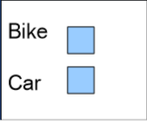
RADIO CHECKBOX
Radio buttons:
<form> <input type=“radio” name=“sex” value=“male”/>Male </br>
<input type=“radio” name=“sex” value=“female”/>Female
</form>
Checkbox:
<form>
<input type=“checkbox” name=“vehicle” value=“Bike”/> <br/>
<input type=“checkbox” name=“vehicle” value=“Car”/> <br/>
</form>

Slide 12
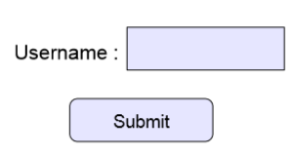
Action attribute and the submit button
<form action=“/action_page.php“ method=“get”>
User name:<input type=“text” name=“user”/><br>
<input type=“submit” value=Submit />
</form>

Slide 13

Vertical and horizontal frameset
<html <frameset cols=“30%,40%,30%”>
<frame src=“frame_a.htm”>
<frame src=“frame_b.htm”>
<frame src=“frame_c.htm”>
</frameset>
</html>

Slide 14
Marquees Html
<!DOCTYPE html>
<html>
<head>
<title>HTML marquee Tag</title>
</head>
<body>
<marquee direction = "right">This text will scroll from left to right</marquee>
</body>
</html>

Slide 15
What does HTML stand for
Hyper Text Markup Language
Hot Mail
How to make Lasanga

Slide 16
Ans: (i) Hyper Text Markup Language

Slide 17
How many tags are in a regular element?
2
1
3

Slide 18
Ans: (i) 2

Slide 19
What type of tag is this <br> ?
Break tag
A broken tag
A opening tag

Slide 20
ANS: ( i ) Break Tag

Slide 21
What does <a href=http://www.google.com title=“link to google” target=“-=_blank”>google</a> do?
Adds a link to google on the page
Adds a search engine to the page
Nothing

Slide 22
ANS:( i ) Adds a link to Google on the page

Slide 23
When was HTML5 released?
1992
2002
2004
2006

Slide 24
ANS:( iv ) 2006

Slide 25
Which of these is not an attribute of html elements ?
Id
Class
Style
Line

Slide 26
ANS: ( iv ) Line

Slide 27
JavaScript

Slide 28
JAVASCRIPT
What is JavaScript ?
JavaScript is a programming language designed for web pages.

Slide 29
HISTORY
First web scripting language
Developed by Netscape and Sun
Initiated by Netscape and called LiveScript
In parallel with this, Sun was developing java

Slide 30
Why Use JavaScript ?
JavaScript enhances Web pages with dynamic and interactive features.
JavaScript runs in client software
JavaScript 1.3 works with version 4.0 browsers.

Slide 31
What can a Java Script do?
JavaScript gives HTML designers a programming tool.
JavaScript can react to events.
Validate Data.
It can be used to detect the visitor’s browser.
Create Cookies.
Read/Write/modify HTML elements.

Slide 32
JavaScript Terminology
JavaScript programming uses specialized terminology.
Understanding JavaScript terms is fundamental to understanding the script.
Objects, Properties, Methods, Events, Function, Values, Variables, Expression, Operators.

Slide 33
Objects
Objects refers to windows, document, images, tables, forms, buttons or links, etc.
Objects should be named
Objects have properties that act as modifiers.

Slide 34
JavaScript Statement
<html>
<head><title>My page</title></head>
<body>
<script language=“javaScript”>
Document.write(‘This is my first JavaScript Page’);
</script>
</body>
</html>

Slide 35
General Format
<!doctype ...>
<html>
<Head>
<Title> Name of web page </title>
<script type="text/javascript">
...script goes here
</script>
</head
<body>
...page body here: text, forms, tables
...more JavaScript if needed
...onload, onclick, etc. commands here
</body>
</html>

Slide 36
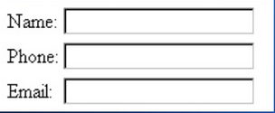
Naming Form Elements in HTML
<form name=“addressform”>
Name: <input
name=“yourname”><br />
Phone: <input name=“phone”>br />
Email: <input name=“email”><br />
</form

Slide 37
Forms And JavaScript
document.formname.elementname.Value
Thus:
document.addressform.yourname.value
document.addressform.phone.value
document.addressform.Email.value

Slide 38
Properties
Properties are object attributes.
Object properties are defined by using the object’s name, a period, and the property name.
e.g., background color is expressed by:
document.bgcolor.
document is the object
bg color is the property

Slide 39
Methods
Methods are the actions applied to the particular objects. Methods are object what object can do.
e.g.,document.write(“Hello World”)
document is the object.
write is the method.

Slide 40
Function
Function are named statement that perform tasks.
e.g., function do Whatever () {statement here}
The curly braces contain the statement of the function.
JavaScript has built-in functions, and you can write your own.

Slide 41
Values
Values are bit of information.
values types and some example include:
Number:1 2 3, etc.
String: characters enclosed in quotes.
Boolean: true or false
object: image, form
function: validate, doWhatever

Slide 42
Finding HTML Elements
Finding HTML elements by Id:
Example: var
x=document.getElementById(‘intro”);
Finding HTML elements by tag name:
Example: var x=document.getElementBYId(“main”);
var y=x.getElementsBYTagName(“p”);

Slide 43
Using Separate JavaScript Files
Linking can be advantageous if many pages use the same script
Use the source element to link to the script file.
<script src=“myjavascript.js”
language=“javaScript1.2”
type=“text/javascript”>
</script>

